Slide 1
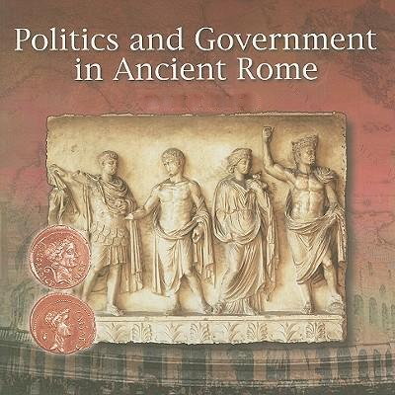

POLITICS

Slide 2
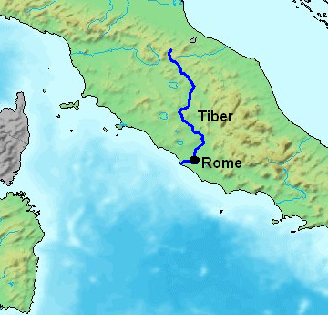
In the Beginning…
Ancient Rome begin as a group of villages along the Tiber River in what is now Italy.
Around 750 B.C. these villages united to form the city of Rome.

Slide 3
Roman Government
MONARCHY
753-509 B.C.
KING
REPUBLIC
509-27 B.C.
DEMOCRACY
EMPIRE
27 B.C.-476 A.D.
EMPEROR

Slide 4
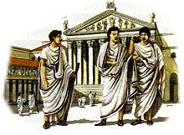
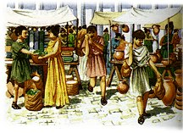
Patricians & Plebeians
In the beginning most of the people elected to the Senate were patricians (the elite who could trace their ancestry to the founding of Rome).
Patricians controlled the law since they were the only citizens allowed to be judges.
Plebeians had the right to vote, but could not hold public office until 287 B.C, when they gained equality with patricians.

Slide 5
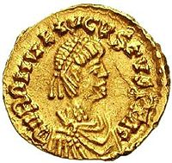
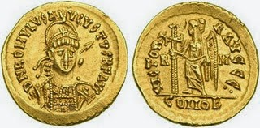
Rex Romae
The King had absolute power over the people
The Senate:
Senate was little more than a weak oligarchy
Could exercise only minor power
Basically it was around to administer the wishes of the King
New Kings (all 6 of them) were elected from the people of Rome
Candidates were nominated by a special senate member called the interrex
The king served as
Head of State
Head of Government
Commander in Chief
Chief Priest
Chief Legislator
Chief Judge

Slide 6
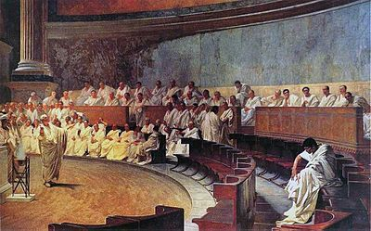
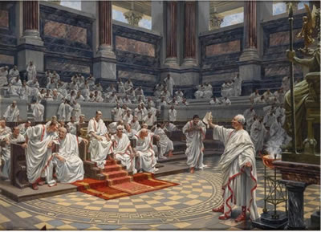
Res publica Romana
Headed by two consuls
Elected by senate
Supervised the senate
Headed the army in war time
Constitution was unwritten, continually-changing, set of guidelines set down by precedent.
Senate mostly gave “suggestions” to magistrates
Many members were elected from the Roman Censors
Optimo Jure elected assemblies who elected magistrates, enacted legislation, and managed foreign affairs

Slide 7
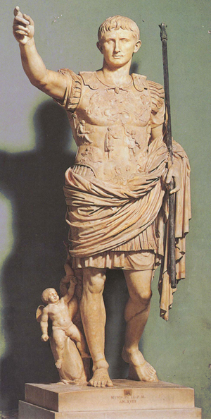
Imperator
Gained legitimacy through his army and recognition by the senate, but mostly by their army
In essence it was a case of whoever had the biggest, most hardened army was the emperor
Preserved some semblance to the previous republican government
Great effort to emphasize Emperors were not Kings until 312 A.D. when hereditary inheritance became general

